Slide 1
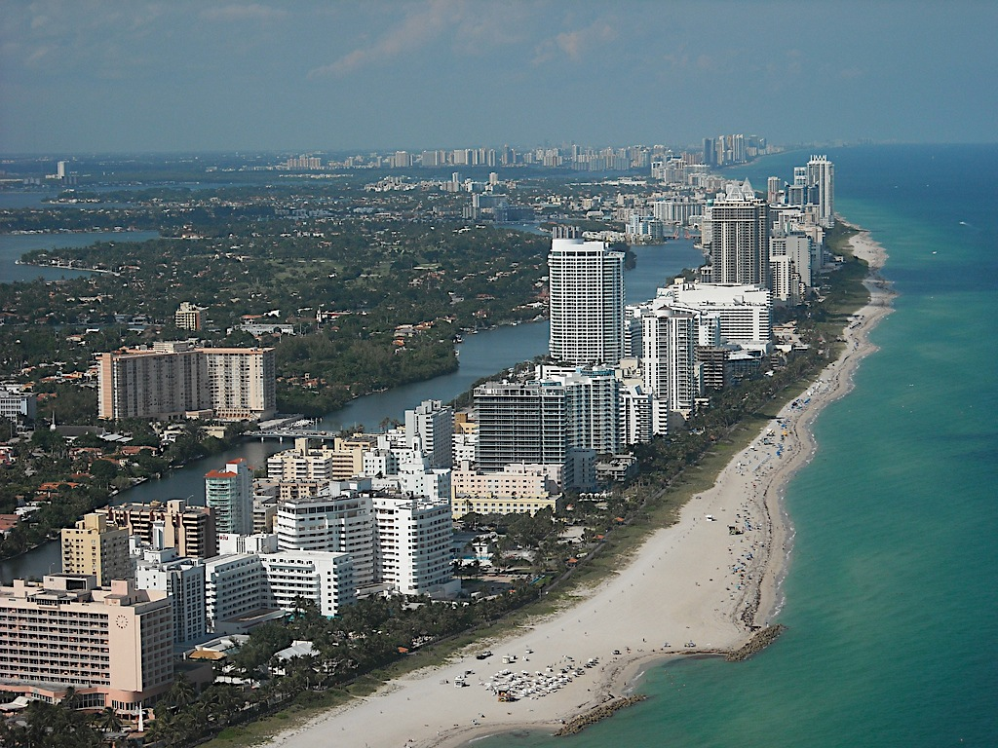
Sensitivity of Coastal Zone Ecosystems to Climate Change
Candy Feller
John Parker
Rick Osman
Dan Gruner
Notes:
Over half the US population in a coastal county, and the density in coastal areas is >5x greater than in inland areas

Slide 2
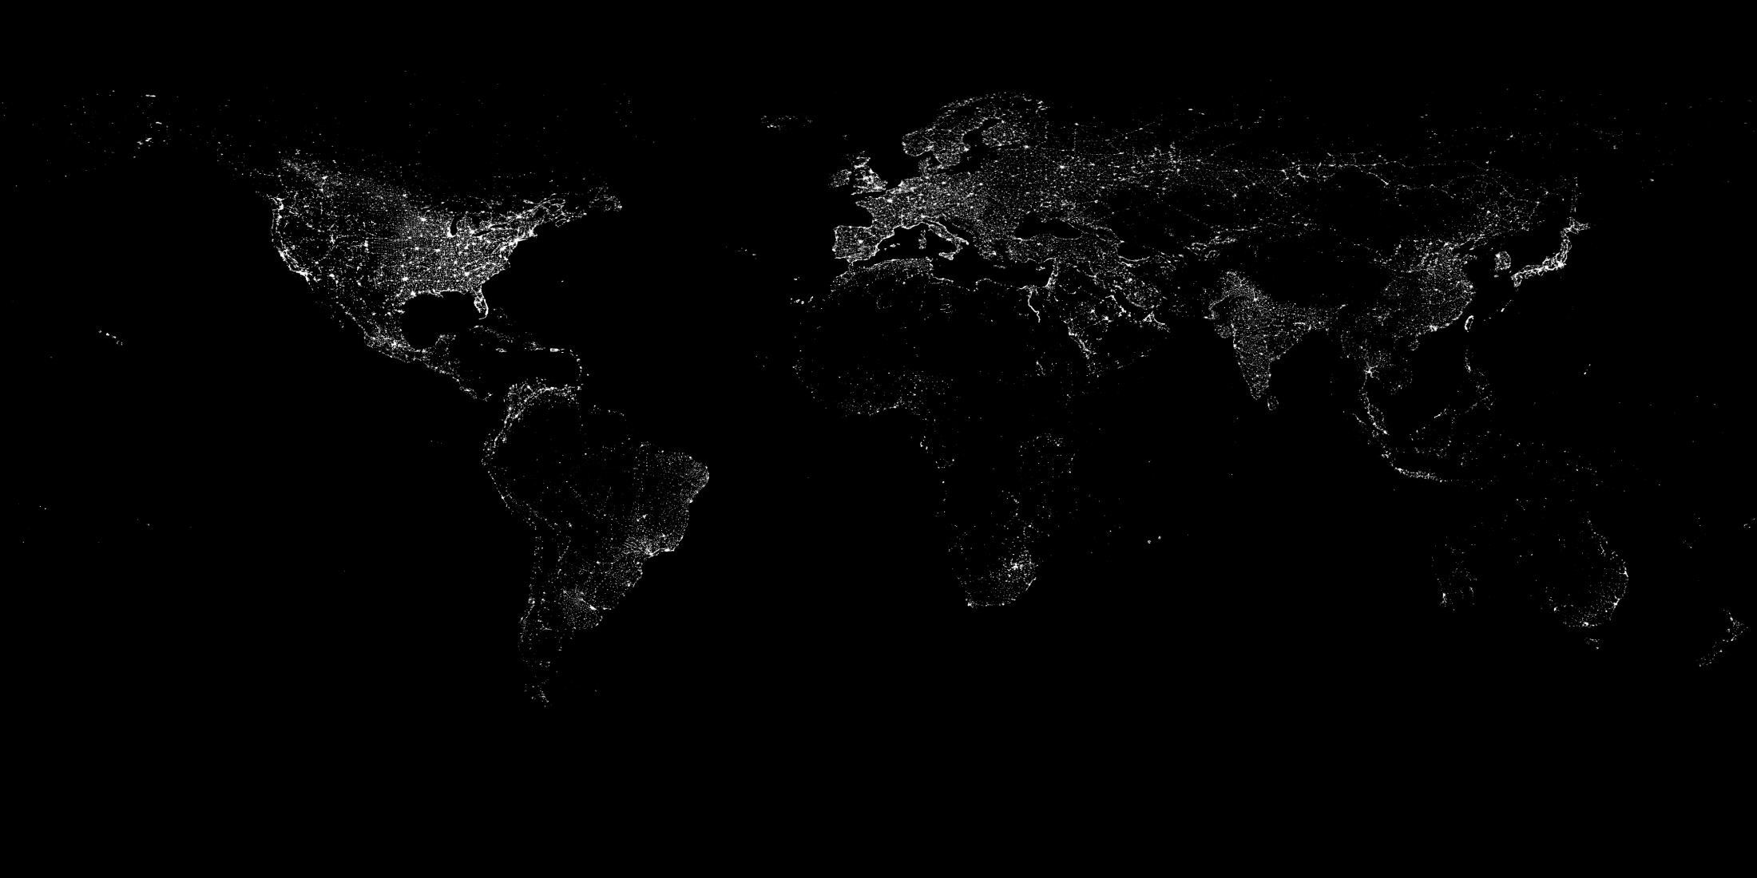
Notes:
Aggregation of human societies along shorelines visible from space

Slide 3
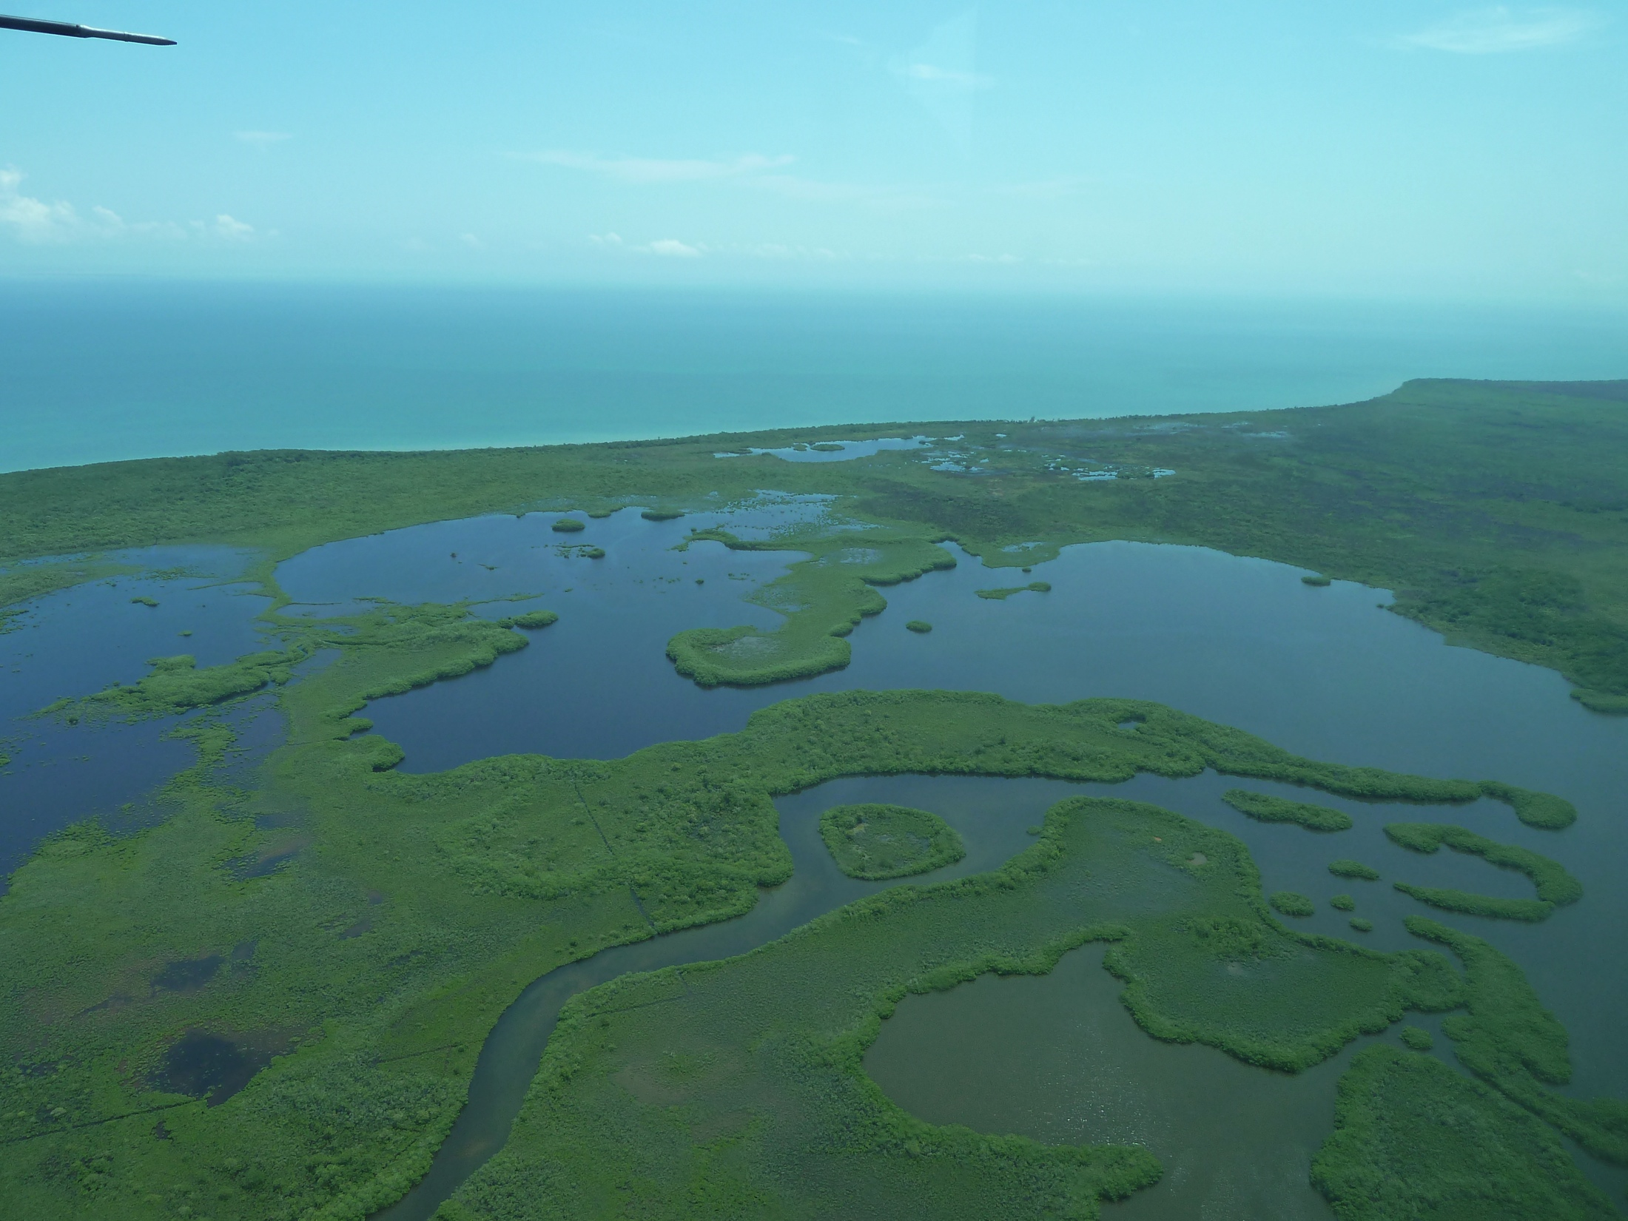
Sensitivity of Coastal Zone Ecosystems to Climate Change
Coastal wetlands = $4.1 trillion/year in ecosystem services

Slide 4
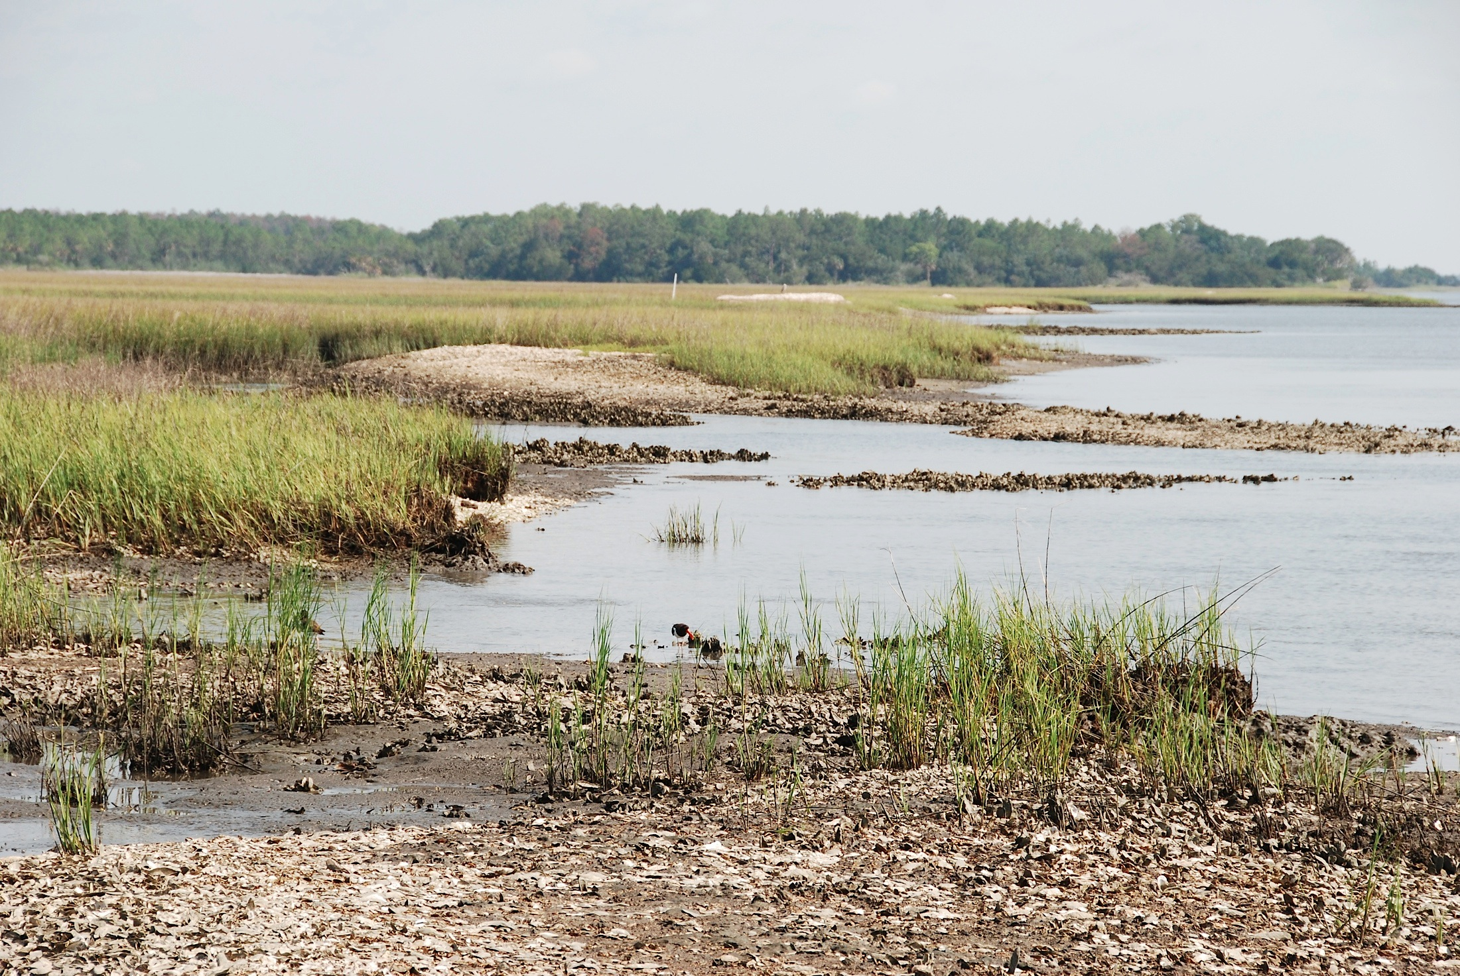
Overview
Alteration of coastal wetlands due to climate change
Mapping via remote sensing
Ecological consequences
Spatio-temporal modeling
Notes:
Picture of wetlands in front of coastal areas, highlight ecological/economic importance of coastal areas

Slide 5
Temperate salt marshes: herbaceous
Notes:
Picture of wetlands in front of coastal areas, highlight ecological/economic importance of coastal areas

Slide 6
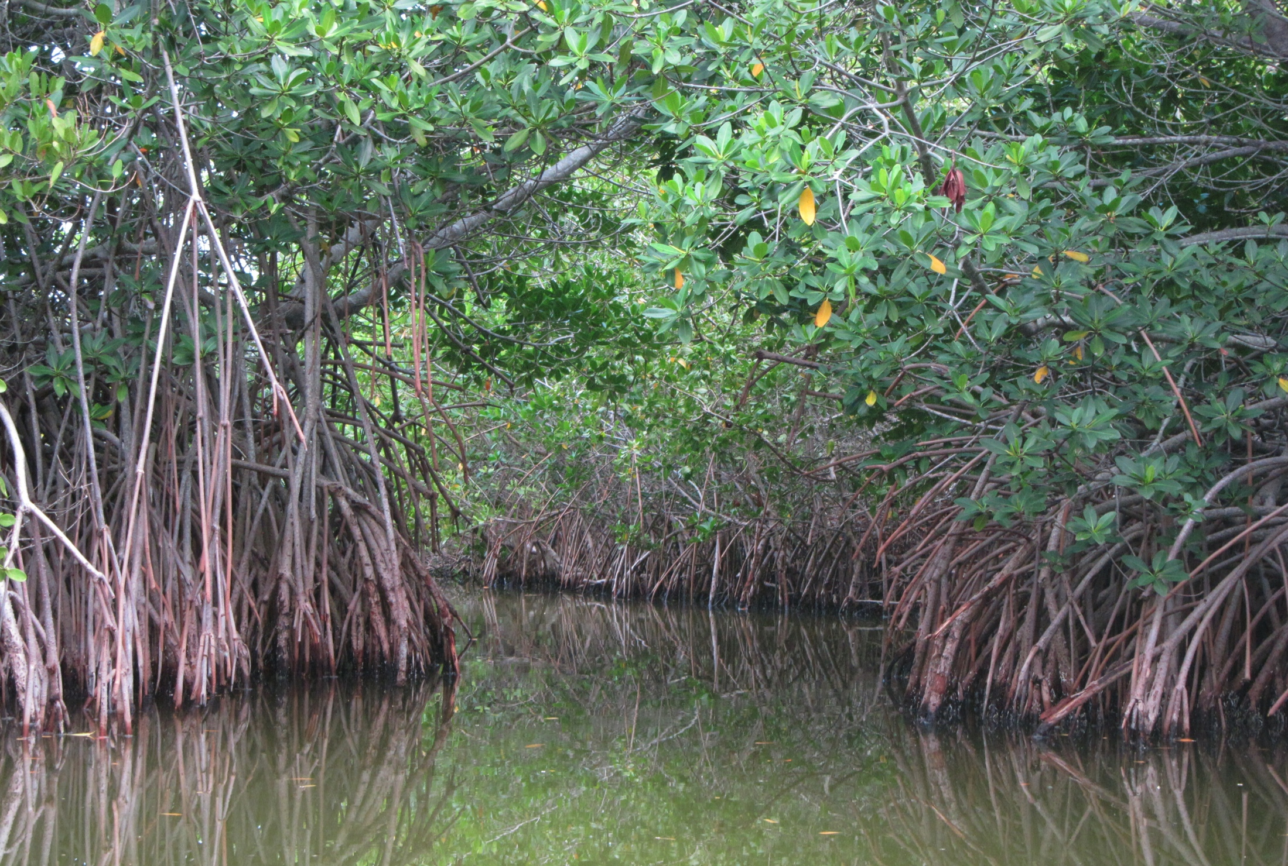
Tropical mangroves: woody

Slide 7
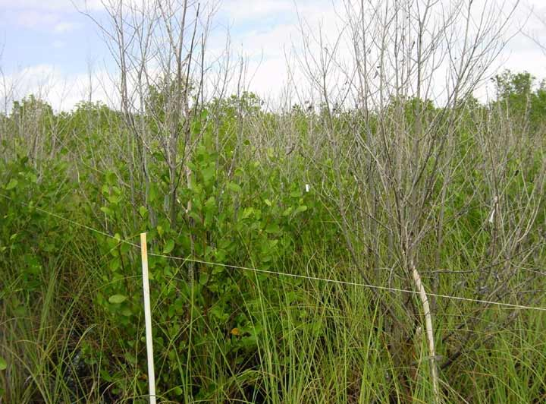
Mangrove die-back from freezing temps

Slide 8
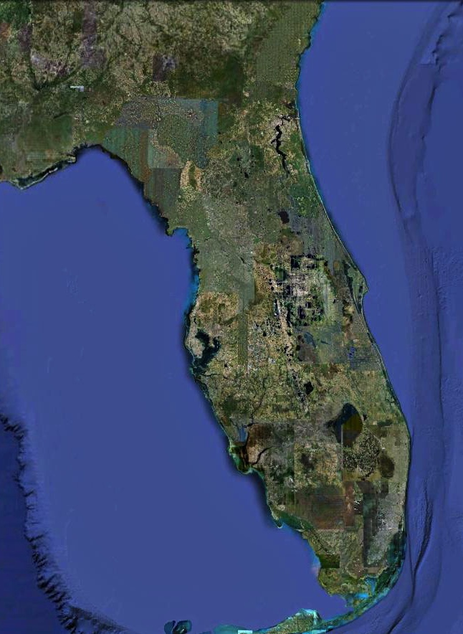
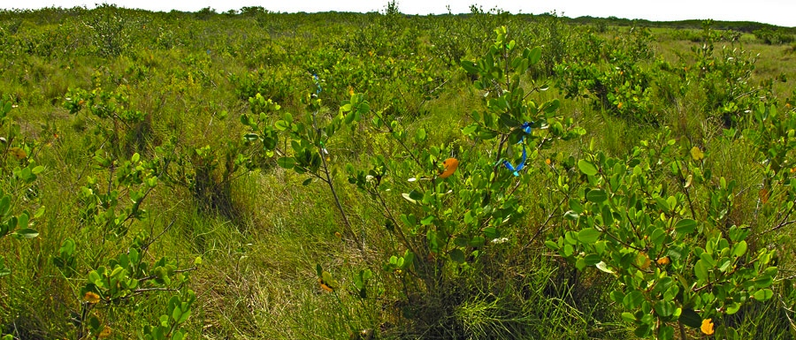
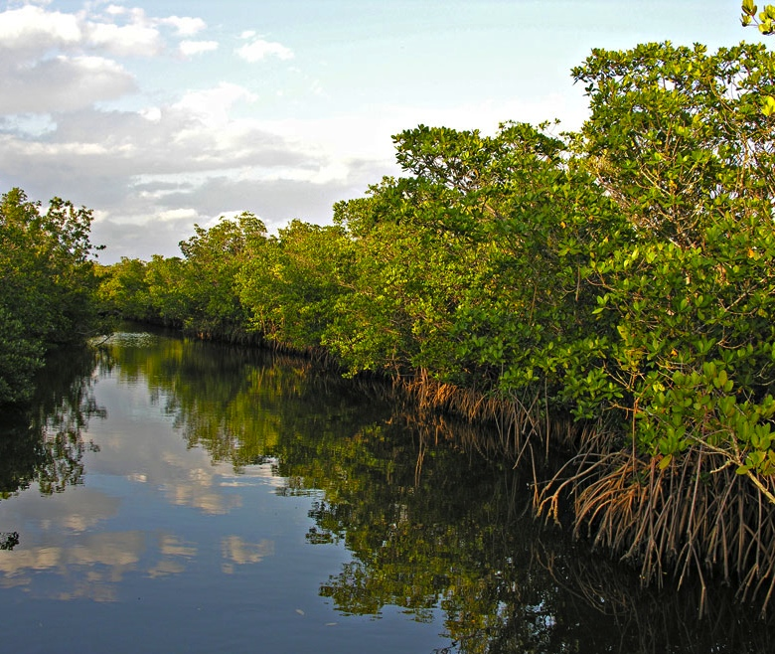
Pure Saltmarsh
Mangrove-Saltmarsh Ecotone
Pure Mangrove
Notes:
The mangrove x saltmarsh ecotone along the Atlantic coast of Florida currently occurs between St Augustine and Cocoa Beach.
In this ~~2 deg latitude, mangroves and saltmarsh species co-occur.
To the south of Cocoa Beach, mangrove forests dominate. Saltmarsh species still occur in small isolated pockets, but extensive saltmarsh does not occur.
North of the ecotone, coastal wetlands are dominated by saltmarshes.

Slide 9
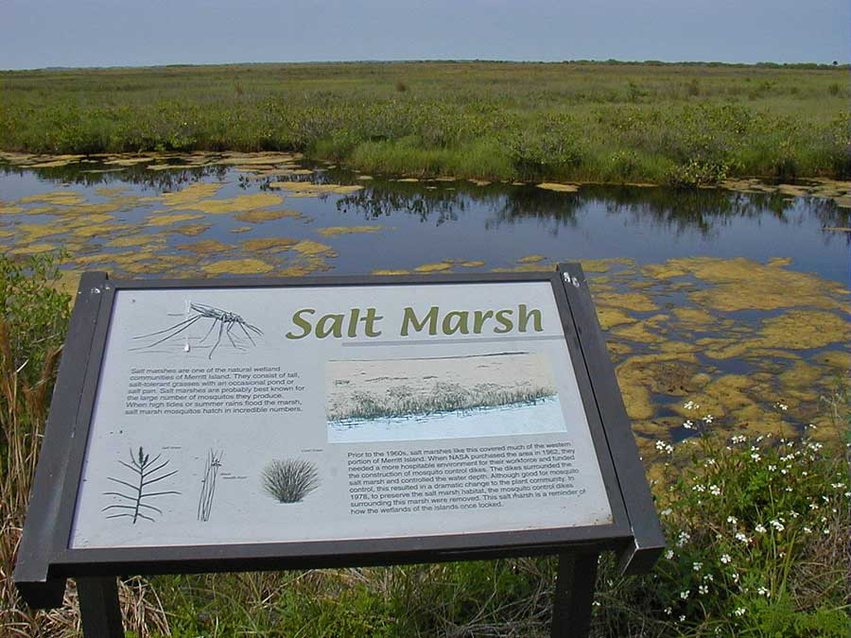
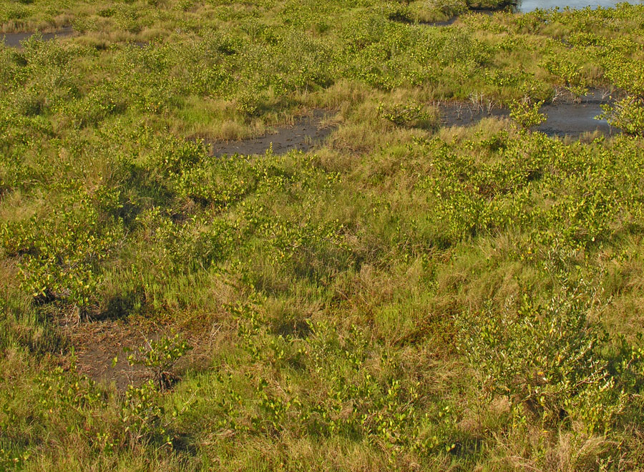
…28°40′ N, Merritt Island National Wildlife Refuge
Notes:
The Merritt Island National Wildlife Refuge is in the current mangrove/salt marsh ecotone.
Here is one of the signs along Black Point Drive through the Refuge. The sign describes this area as a salt marsh and says that the plant species that occur here are salt tolerant grasses.
This system is still a coastal wetland, but it has changed since the sign was put out.
A close look shows that mangroves have invaded since the sign was set up… here mainly Avicennia has become established in this wetland. There is now as much mangrove as there is salt marsh.

Slide 10
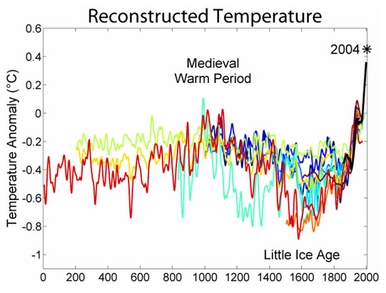
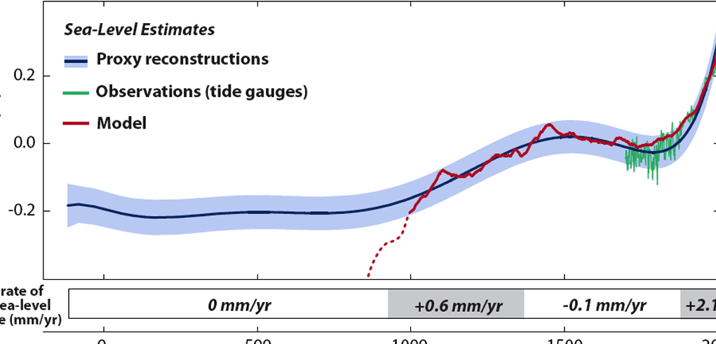
Predicted sea level rise:
~0.6 meters/100 years
(IPCC, 2007)
Kemp et al (2011) PNAS
Notes:
Rising temperatures melts polar ice caps, leading to rising sea level

Slide 11
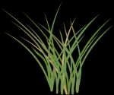
Sea level rise, coastal wetlands, & land use
Predicted sea level rise: 0.18 to 0.59 meters/100 years (IPCC, 2007)
Notes:
Historically, coastal marshes would have risen with sea level, but now hardening of shorelines leaves coastal marshes no where to go

Slide 12
Notes:
Interaction b/w climate change and land use

Slide 13
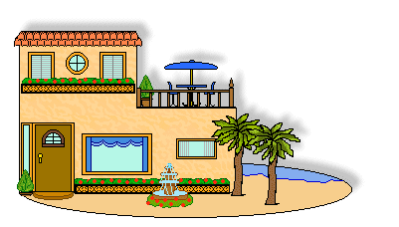
Sea level rise, coastal wetlands, & land use
Predicted sea level rise: 0.18 to 0.59 meters/100 years (IPCC, 2007)
Notes:
Historically, coastal marshes would have risen with sea level, but now hardening of shorelines leaves coastal marshes no where to go

Slide 14
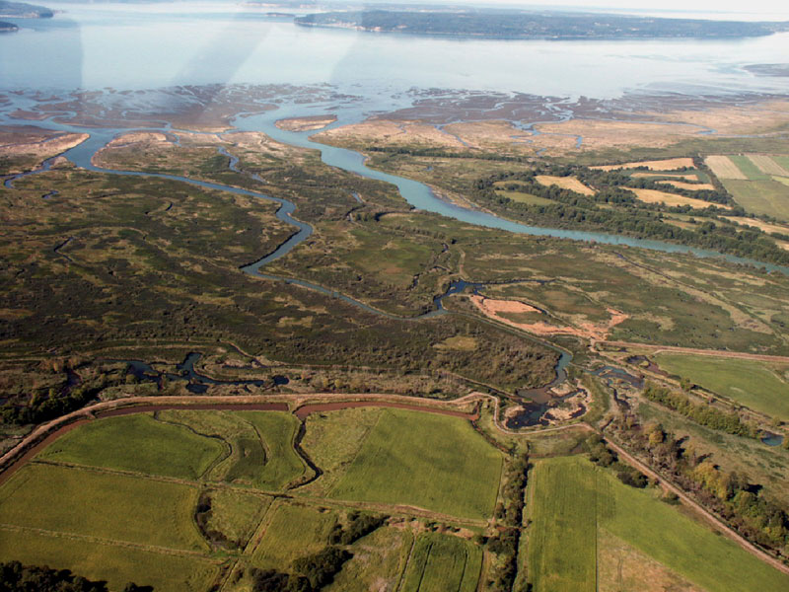
Sea level ‘squeeze’

Slide 15
…conversion of coastal wetlands into shrimp farms
Notes:
Shrimp farming has caused the greatest loss of mangroves. Despite the value of intact mangroves for providing habitat for fish and supporting local fisheries, shrimp farms continue to expand. In some parts of the world, this industrial approach has destroyed the livelihoods of local fishermen…. All for the sake of cheap shrimp. In Thailand, ~90% of the mangroves have been cleared for shrimp farms. There has been some restoration… the Philippines, VietNam.

Slide 16
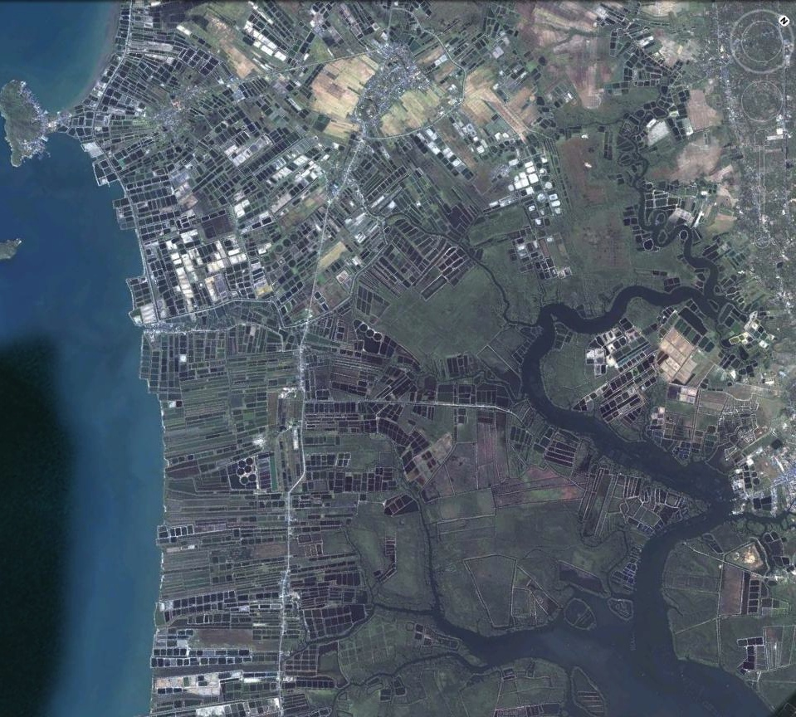
…conversion of mangrove forests to shrimp farms in Thailand
Notes:
In Thailand, ~90% of the mangrove forests have been converted into industrial shrimp farms. 75% of the supply of farm raised shrimp comes from Thailand, Indonesia, and Viet Nam.

Slide 17
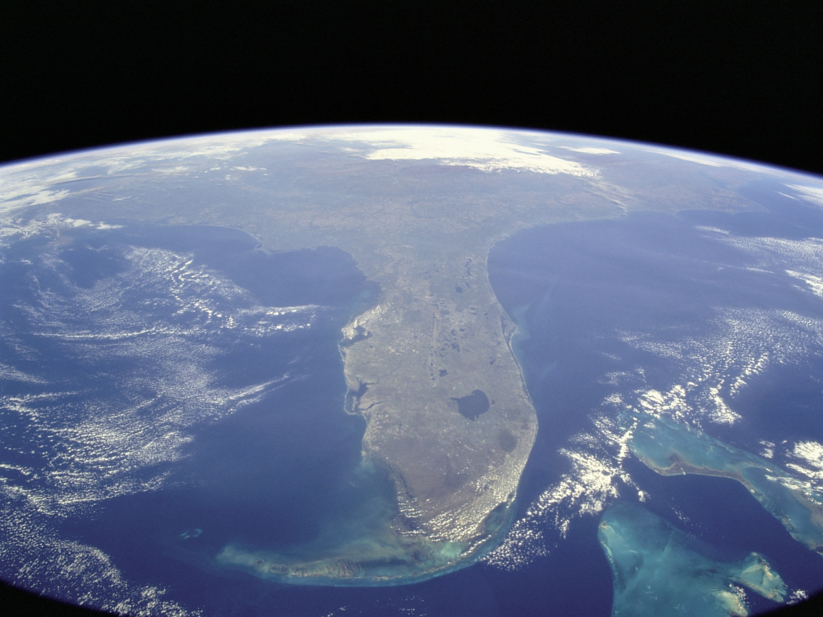
Objective 1 Establish past & present mangrove distribution in Florida

Slide 18
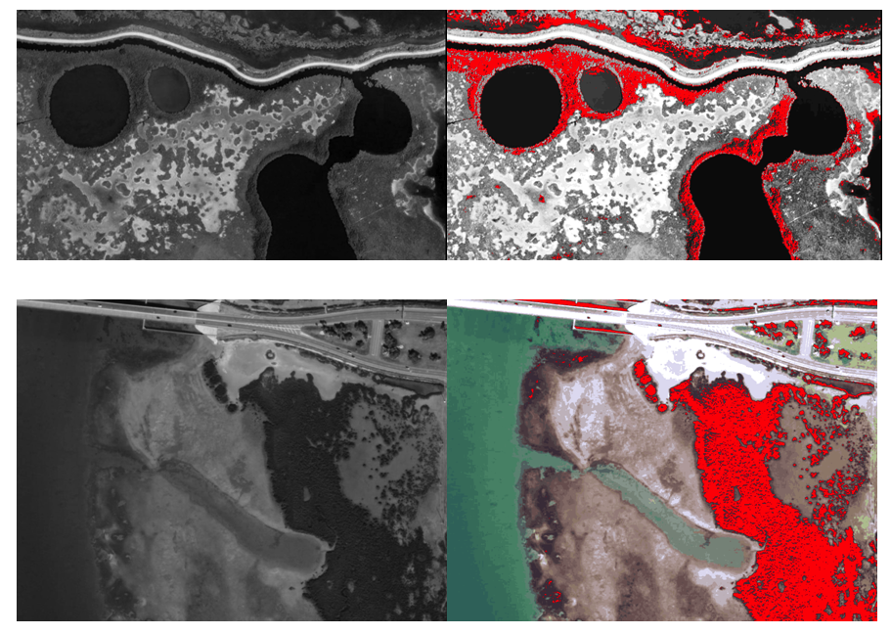
Figure 2. Unsupervised classification image analysis distinguishes mangrove from salt marsh in two areas of mangrove encroachment: Merritt Island, FL (top row) and South Padre Island, TX (bottom row). At left are grayscale images taken from QuickBird satellite, at right are results of classification with mangrove pixels highlighted in red. Methods following Everitt 2008.

Slide 19
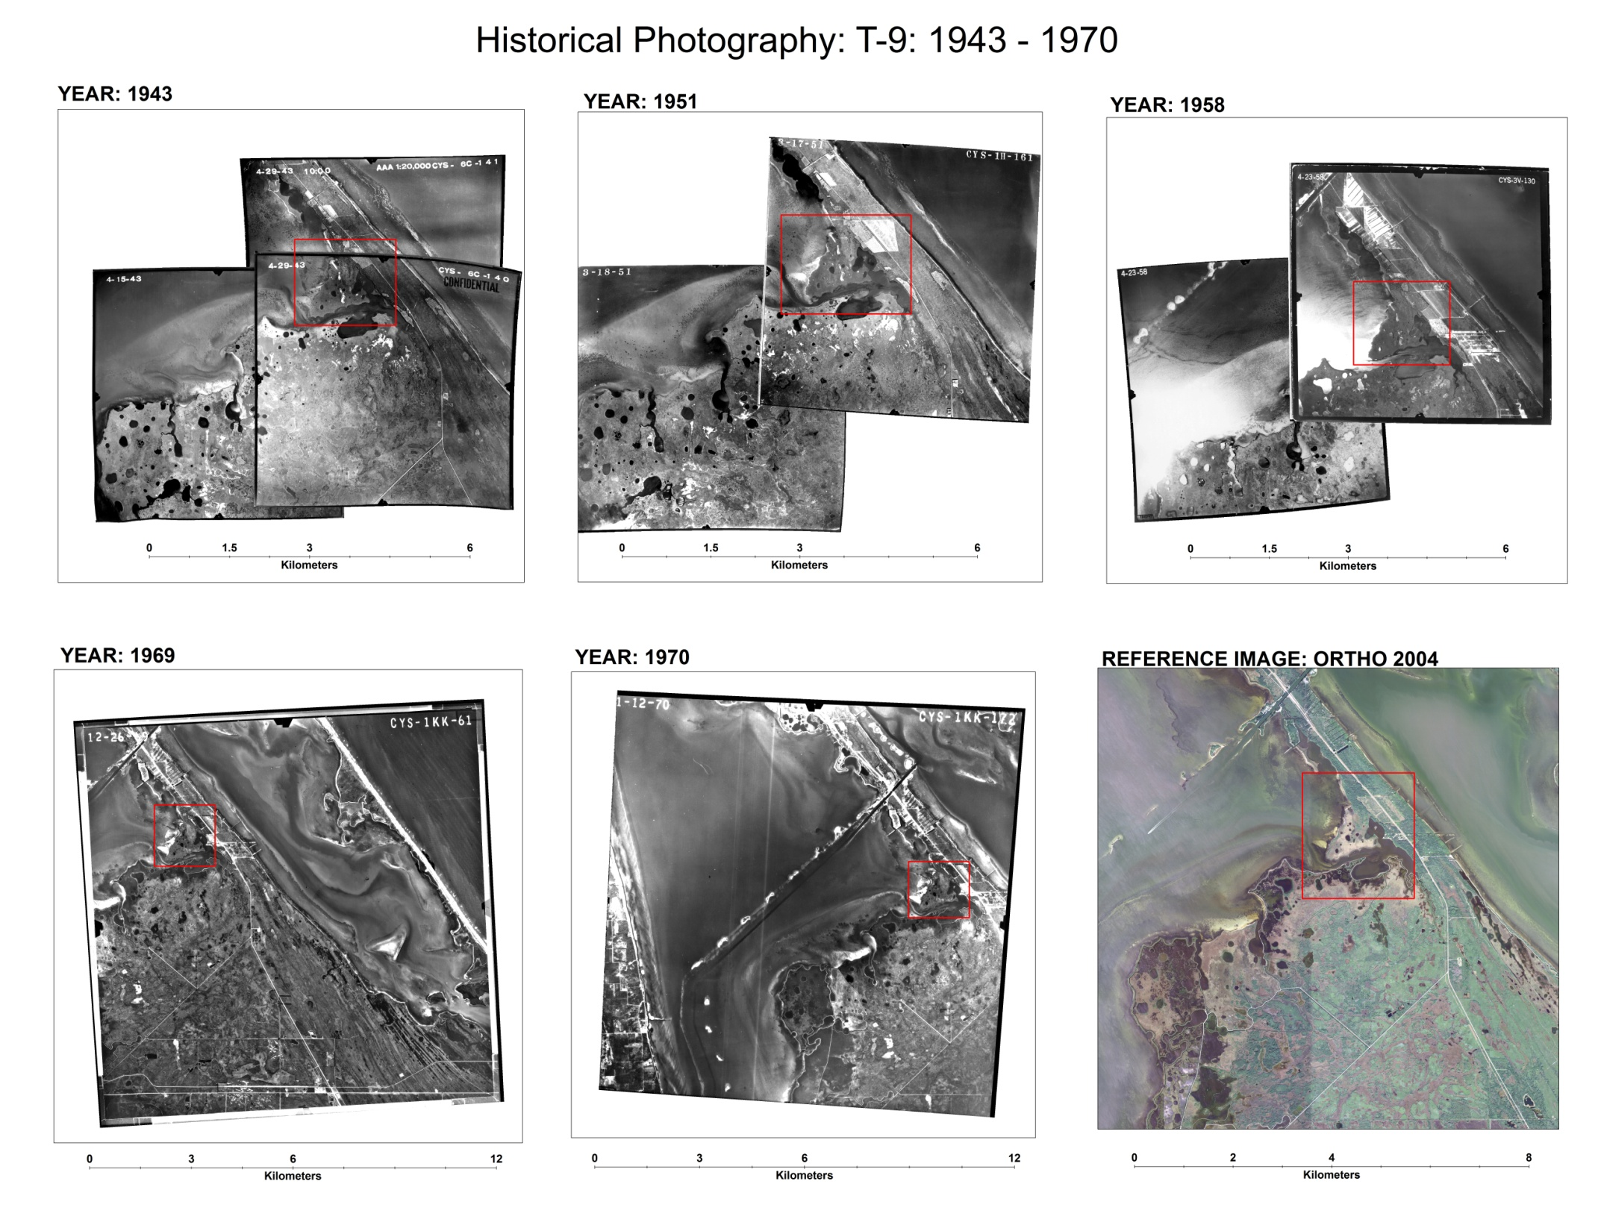
Notes:
Site T-9 is shown within the red-square.

Slide 20
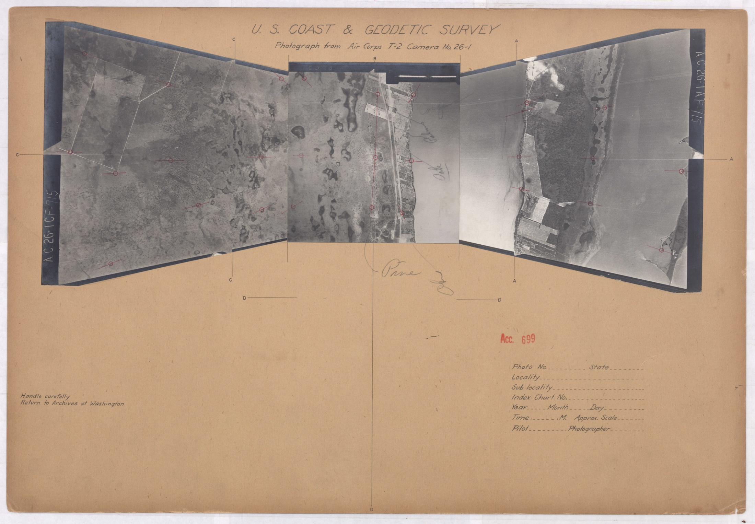
1928 aerial photography, US Coast and Geodetic Survey
Notes:
We are trying to find the way to get hold of the original black&white aerial photography of Brevard taken by the US Coast and Geodetic Survey back in 1928. D. Scott Taylor has provided to us the entire set as is (i.e., example shown). To use it in the historical analysis I would like to scan individual prints and then georeferenced them.

Slide 21
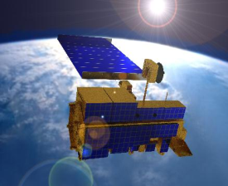
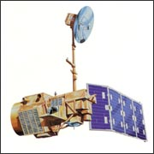
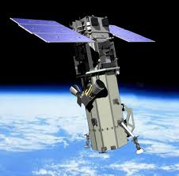
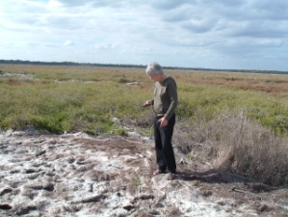
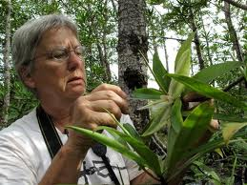
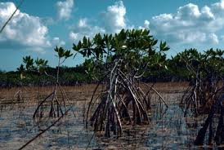
Data Up-scaling
MODIS
(250 – 500m)
ASTER
REGIONAL - GLOBAL
Landsat 5
(15 – 30m)
LANDSCAPE - REGIONAL
WorldView-2
(0.6 – 1.0 m)
FOREST STAND - LANDSCAPE
FIELD TRANSECTS - QUADRATS
Notes:
We are using a variety of remotely sensed data from different sensors that give us the capacity to model habitat changes at different spatial extents and temporal windows. Field measurements of biophysical variables will be used to calibrate satellite images.

Slide 22
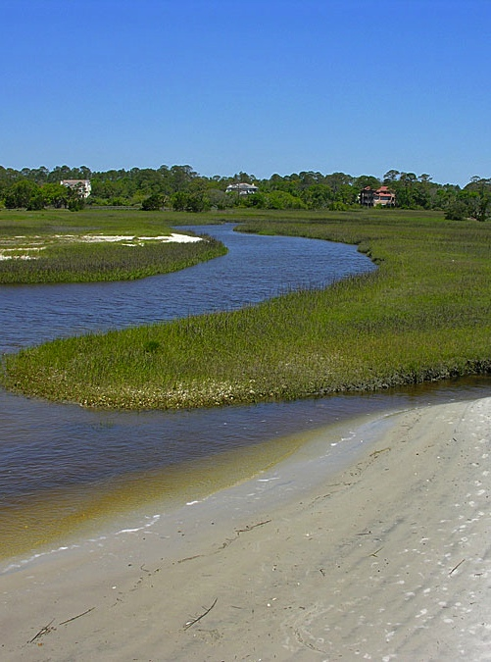
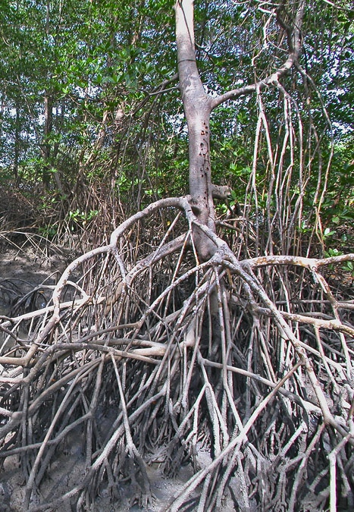
Objective 2 Ecological consequences

Slide 23
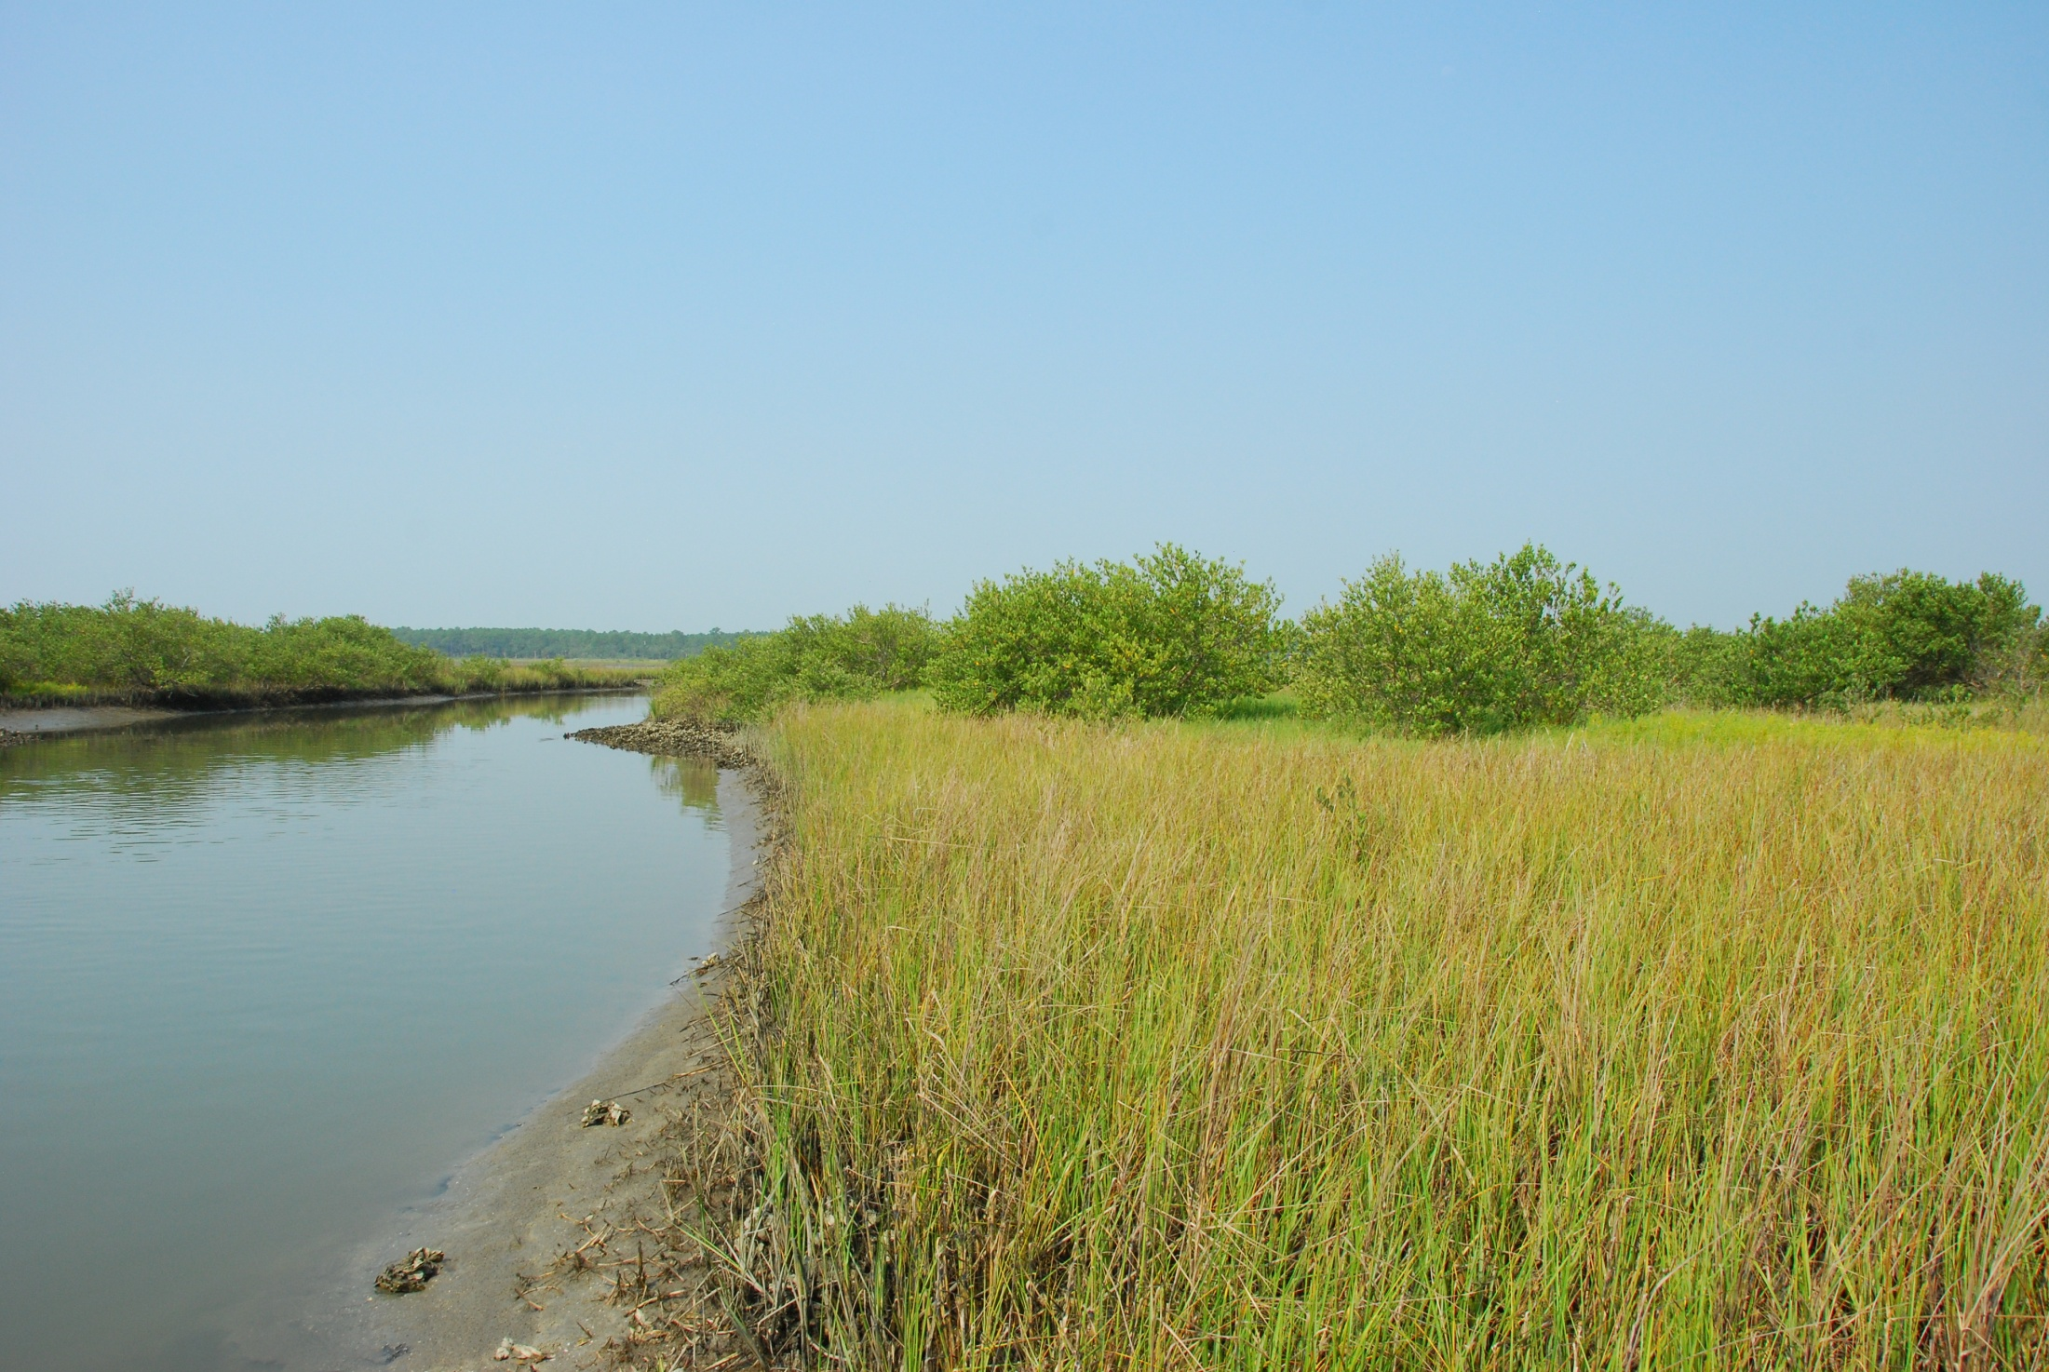

Slide 24
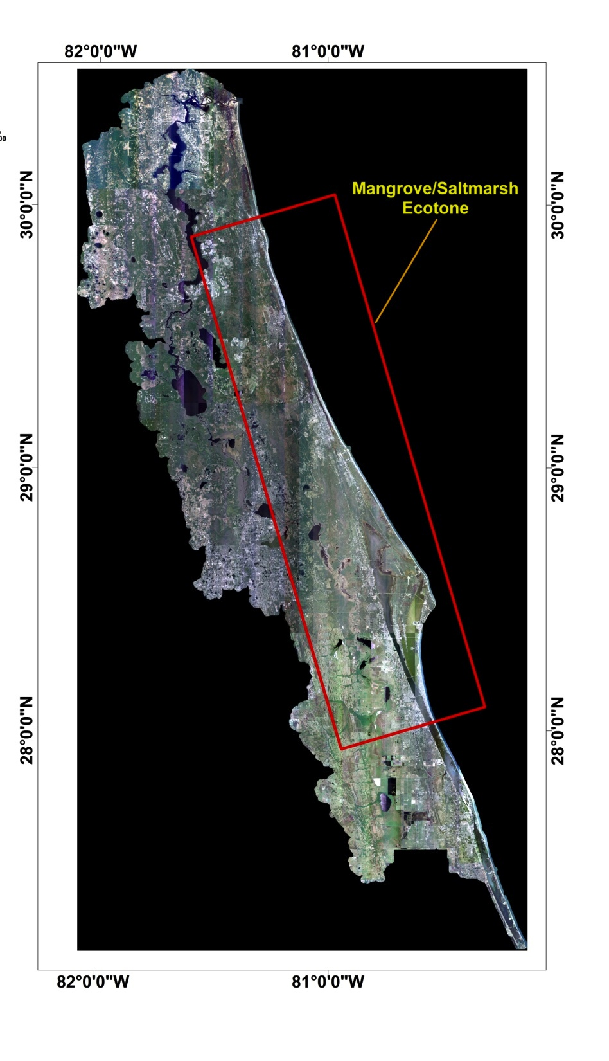
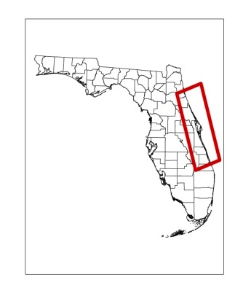
Chronosequence of mangrove invasion
N= 21 sites, pure mangrove to pure salt marsh
N=5 mapped plots at each site
Notes:
All remotely sensed data has been processed with ERDAS Imagine and ArcGIS. Here we show the extent of the different watersheds that make up the area of study. The mangrove/saltmarth ecotone is shown within the red square. To the south of it, we will find mostly mangroves forests. To the north of it, only saltmarshes.

Slide 25
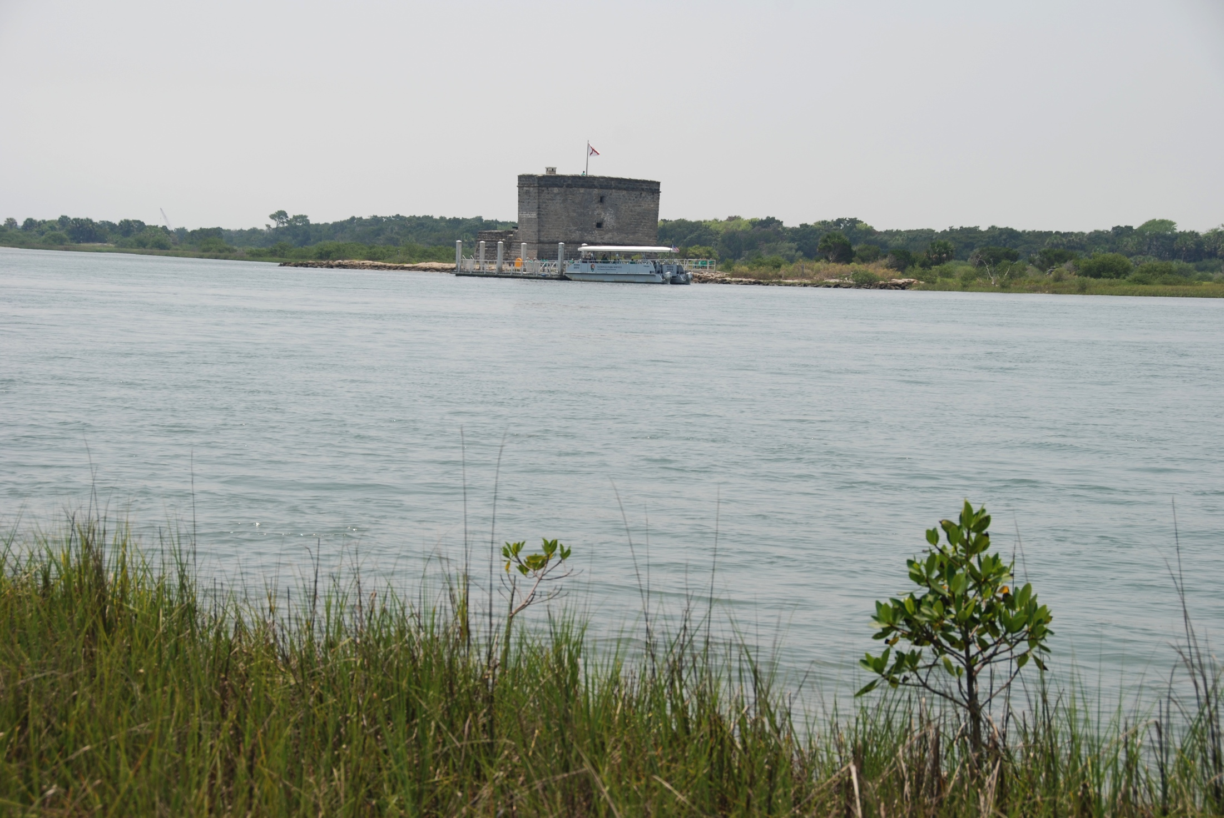
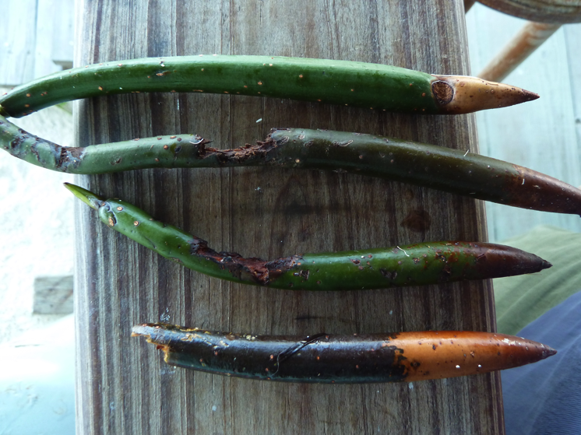
Mangrove demography (survival, growth, mortality)

Slide 26
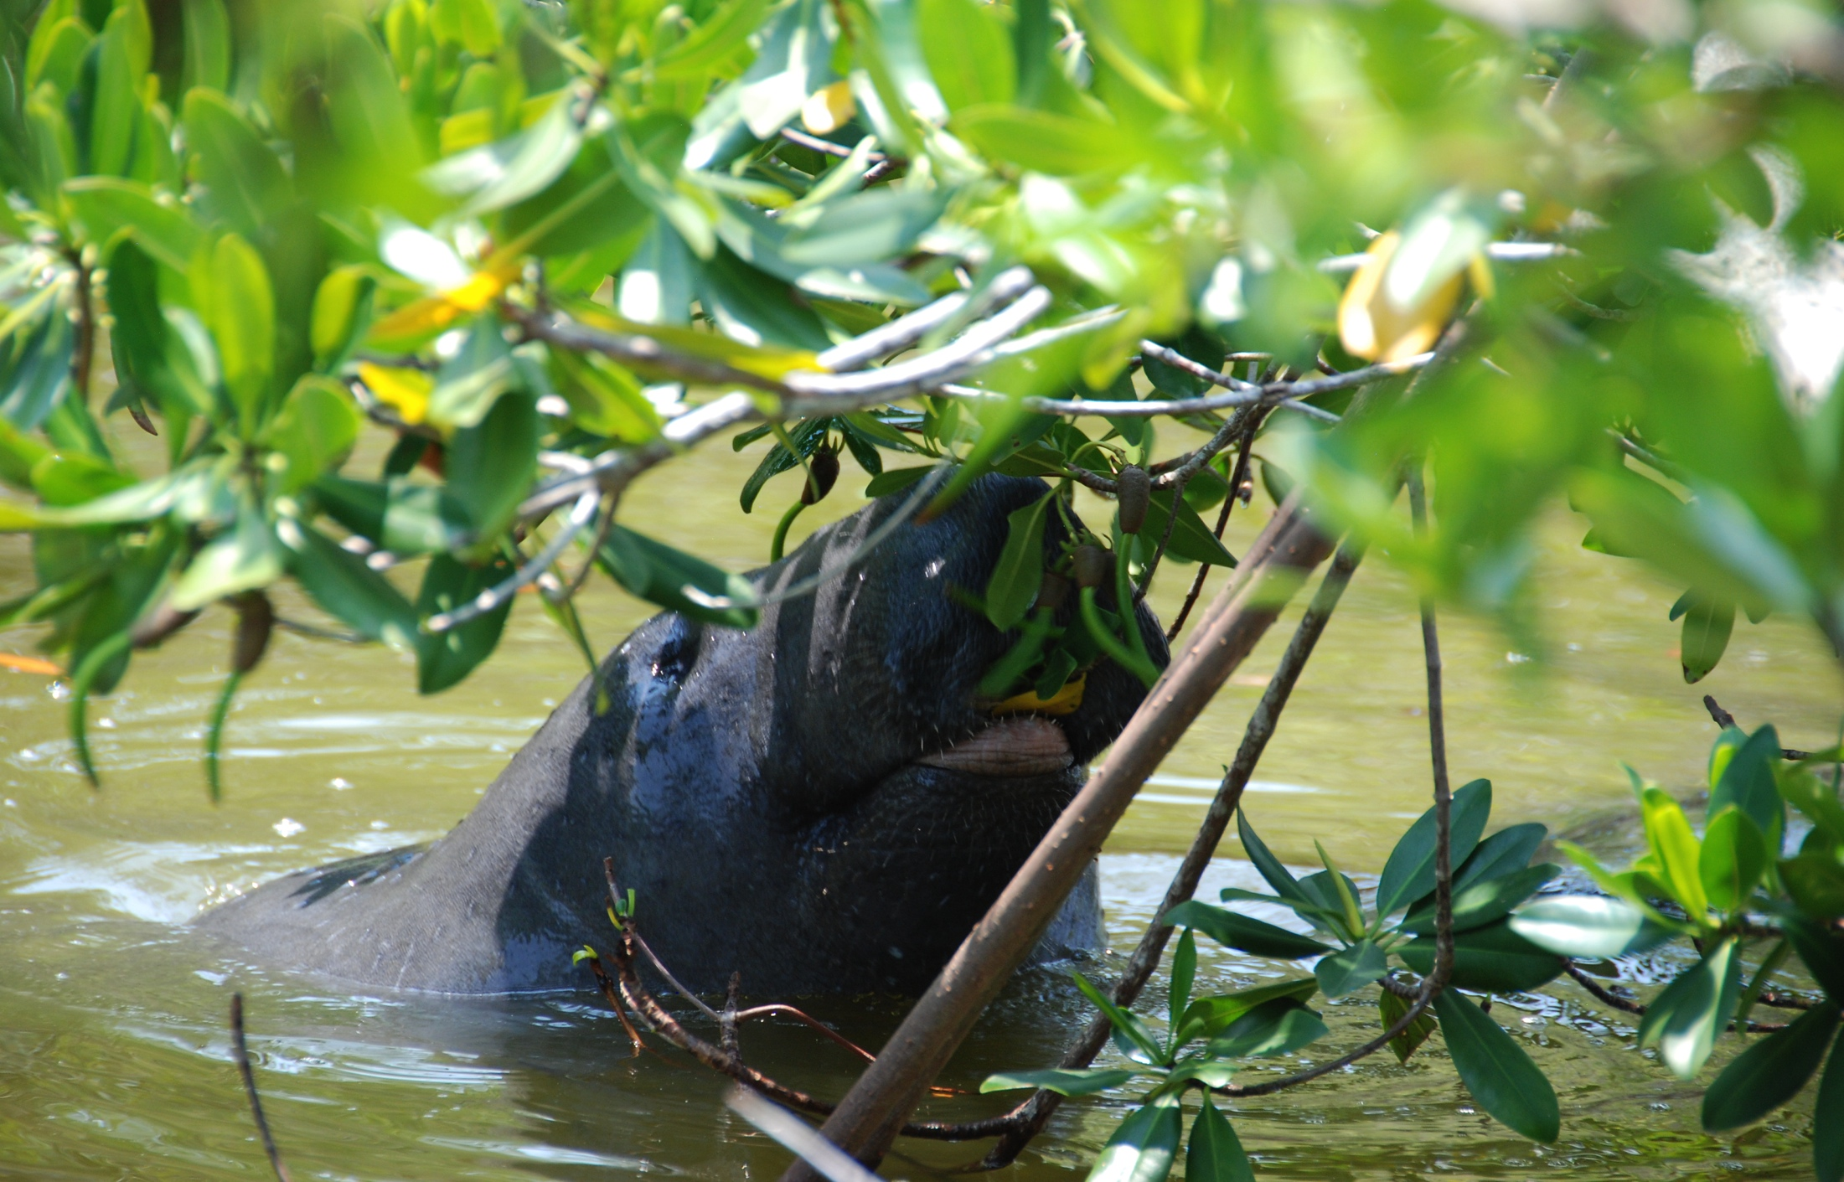
Biodiversity

Slide 27
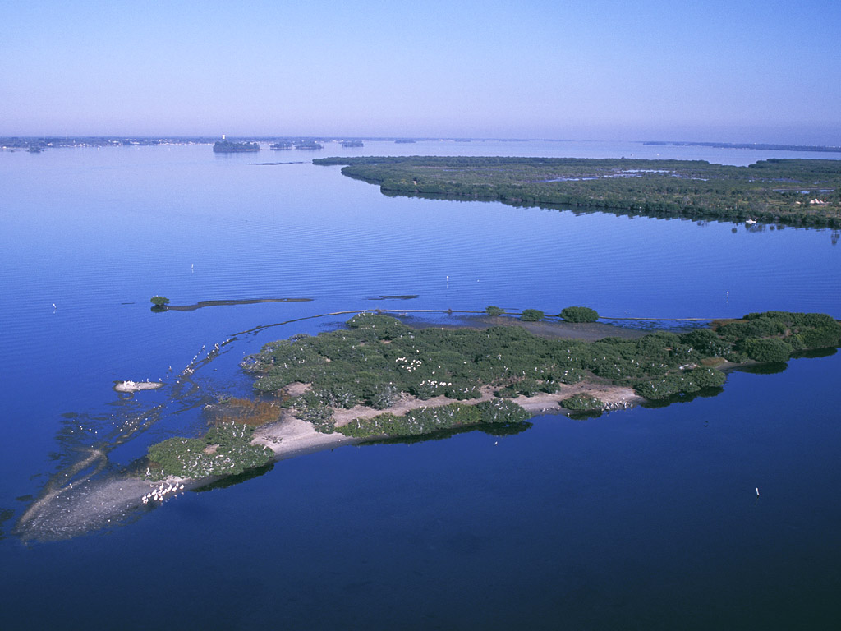
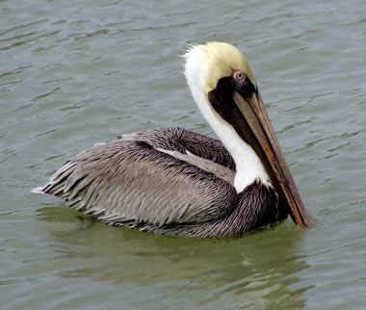
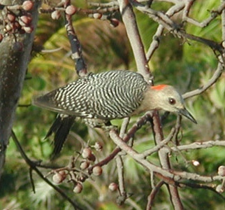
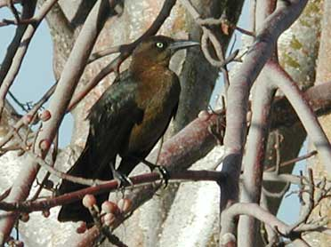
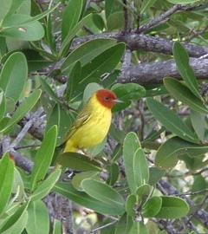
Birds

Slide 28
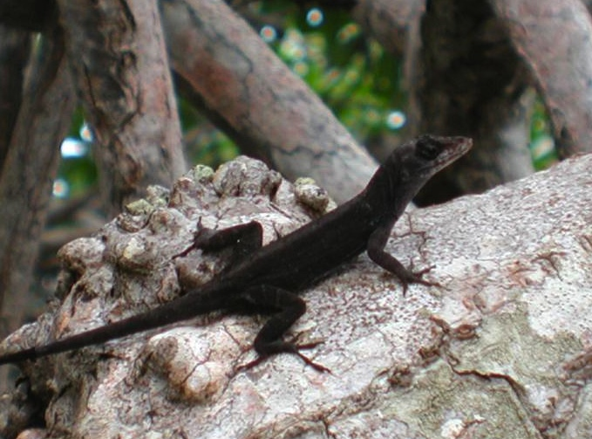
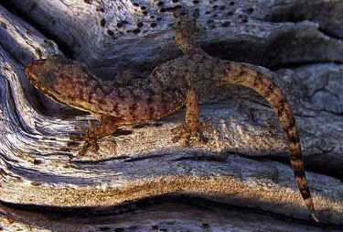
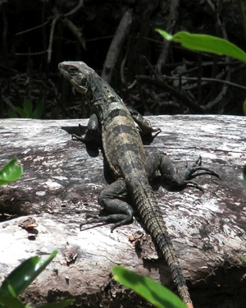
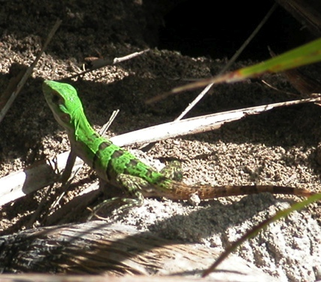
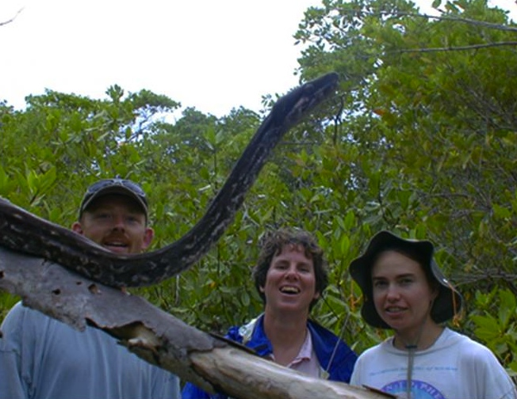
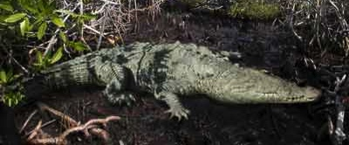
Reptiles
Notes:
A diverse array of reptiles use the mangrove, including both alligators and crocodiles. Alligators are found in low salinity areas. We have the American crocodiles in South Florida, but it has become quite rare. The largest remaining population of the American crocodile occurs atTurneffe Atoll in Belize. In Australia, the salt water crocodile is concern for people working in mangroves. Mangroves also harbor other reptiles including snakes, lizards, turtles.

Slide 29
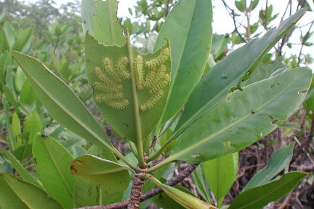
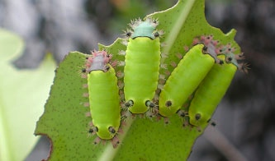
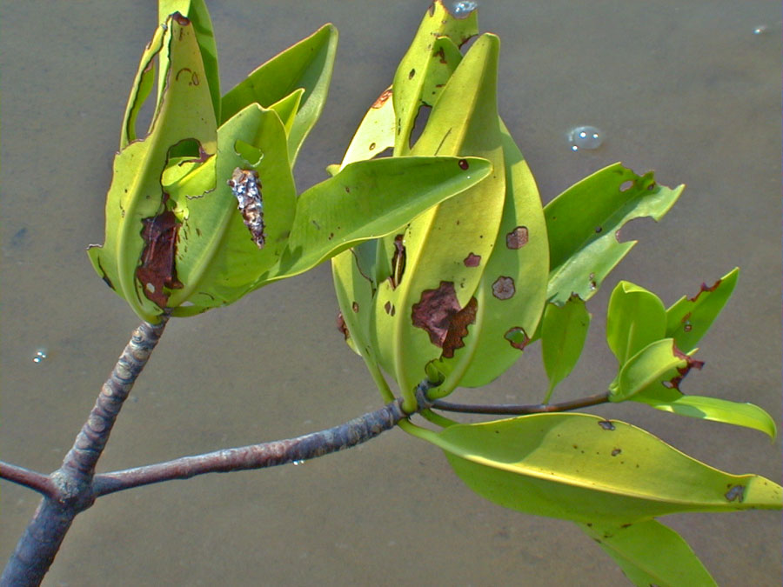
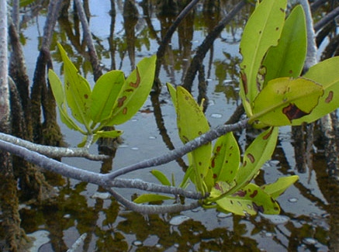
Insects
Notes:
Mangroves are also food for a number of generalist herbivores… these are animals that can feed on a variety of species.

Slide 30
Intertidal crabs
Notes:
Uca sp…. Similar to salt marsh fiddler crabs. Crabs are important fisheries in mangrove areas around the world. This one here is Ucides cordatus… hairy land crab… major fishery for these crabs along much of the Brazilian coast.

Slide 31
Notes:
Why are mangroves and saltmarshes so important?
By filtering sediments and nutrients out of upland runoff, mangroves help to maintain coastal water quality. Adjacent ecosystems… seagrass beds and coral reefs are dependent on this buffering capacity to maintain the low nutrient, clear water they require.
Their roots trap sediments, form peat, and thereby stabilize the shoreline
Mangroves also serve as natural protection during storm events. Here, the forest was severly damage by a category 4 hurricane in Oct 2001. 9 months later, it is recovering. But the forest absorbed the wind and waves from the storm.

Slide 32
Objective 3 Spatio-temporal modeling of mangrove invasion
STELLA
Individual-recruit transport model
Hierarchical
modeling
Field data
GIS

Slide 33
Working hypothesis: climate * land use interaction drives mangrove abundance, altering ecosystem function

